Slide 1
Mitigation of the Verifier’s Dilemma in Proof-of-Stake Ethereum Blockchain

Slide 2
Introduction
Blockchain technology has become an integral component of modern digital infrastructures, extending far beyond its initial use in cryptocurrencies, for example, with the use of smart contracts.
In 2022, Ethereum completed its transition from the Proof-of-Work (PoW) consensus protocol to the more energy-efficient and economically grounded Proof-of-Stake (PoS) mechanism.
Under PoS, validators replace miners and are responsible for verifying and attesting the correctness of newly proposed blocks. Their participation is economically incentivized through rewards and penalties tied to their voting behavior.

Slide 3
Analysis of the Verifier’s Dilemma in PoS
Ethereum’s new PoS consensus introduces a critical issue known as the Verifier’s Dilemma.
Validators are expected to verify each block before attesting to its validity, which is time-consuming due to:
execution of complex smart contracts
unpredictable network conditions
strict timing requirements imposed by slot-based attestation.
Delayed attestations result in reduced rewards, or even penalties, which incentivizes validators to skip block verification to cast their vote immediately, which is detrimental to global network security, as it increases the likelihood of the acceptance of invalid / malicious blocks.

Slide 4
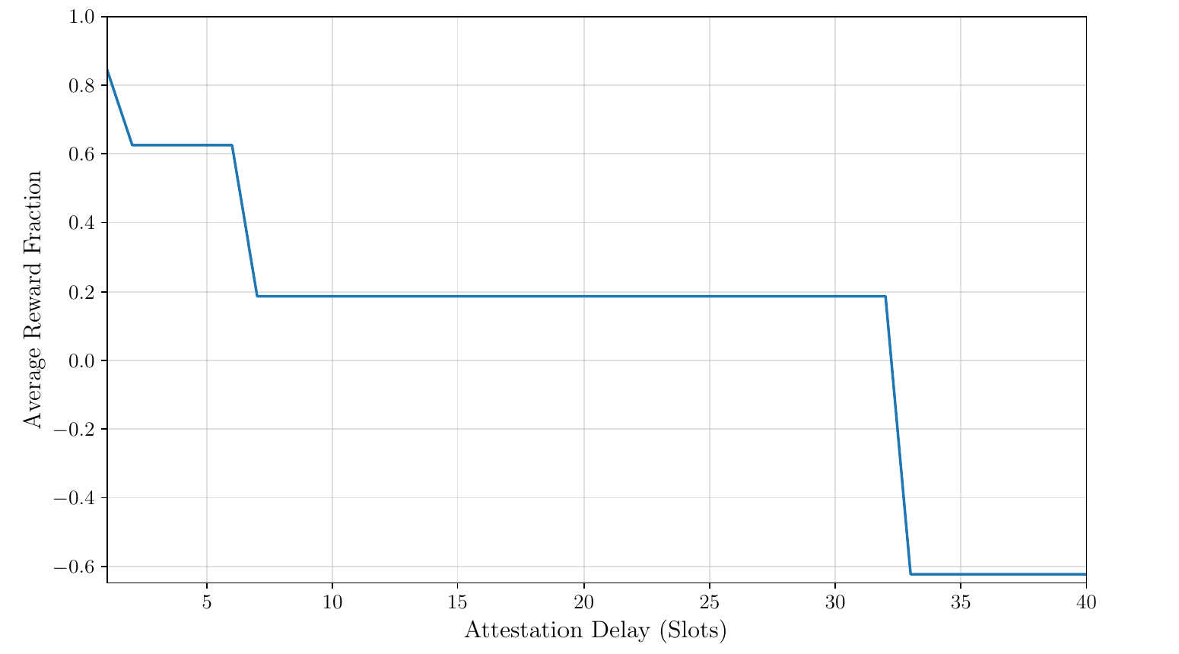
Analysis of the Verifier’s Dilemma in PoS
The given rewards get fractioned based on the slot delay that a validator required
to validate the proposed block.
Vote Delay | Reward Fraction
1 slot | 0.844
1 < delay ≤ 5 slots | 0.625
5 < delay ≤ 32 slots | 0.187
delay > 32 slots | -0.625

Slide 5
Modelling Approach
To analyze this phenomenon, we leveraged a formal model based on the Performance Evaluation Process Algebra (PEPA) to capture the distinction between:
fair validators, who always verify before voting and incur in voting delays
unfair validators, who vote without verification to maximize rewards
the reward/penalty policies defined by Ethereum PoS
Through the associated Continuous Time Markov Chain (CTMC), we’ll compute the steady-state probabilities and derive expected reward fractions for fair and unfair validators across several scenarios.

Slide 6
Model Assumptions
We assume to have Continuous Time Markov Chains such that they are:
Time Homogeneous: transitions are independent from the observation time
Irreducible: every state can be reached from any other state
Ergodic: for each node, there exists a finite path that returns to itself
Notes:
Queste sono le assunzioni che abbiamo per generare il derivation graph e gestire le CTMC

Slide 7
Components and their Interactions
We identified the following components, i.e., the active units within the system that do some activities given by the activity type in a specified time given by the activity rate while, usually, cooperating with other activities.
Slot Component (Slot_i)
Fair Validator (VF)
Unfair Validator (VU)
Delay Component (Delay)
Network Component
Notes:
Reminder: attivitò (\alpha, r), dove alpha è l’activity type e r l’activity rate, alpha è \tau se non ha un nome e non ci si può sincronizzare, il rate è \top se non è specificato
Il rate ha distribuzione esponenziale con probabiility density function P[X<=t] = ]1-e^{rate * t}

Slide 8
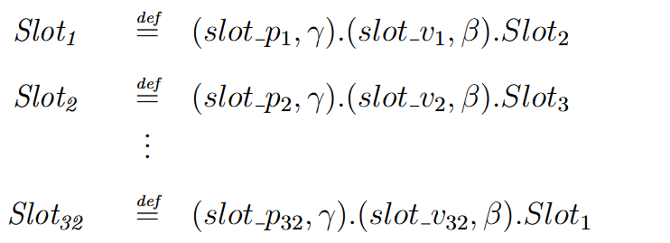
Slot Component (Slot_i)
Slots represent the time unit of the blockchain, and are divided in two phases:
Block Proposal, where slot_pi indicates the rate at which new blocks are proposed for voting
Attestation / Voting, where slot_vi indicates the rate at which the proposed blocks get voted
Once the two phases are completed, a new slots starts.
Notes:
I blocchi vengono proposti da un validatore e votati dagli altri nello stesso slot. Se un voto arriva tardi, si incorrono nelle penalità

Slide 9
Unfair Validator (VU)
This validator behaves selfishly, given that it does not verify the proposed blocks, which means that it votes immediately and always receives maximum rewards while compromising security.
This means that he cannot incur in penalties for delayed responses.
Notes:
Teoricamente questo componente si sincronizza solamente sulla network per il primo slot in cui voto e sull’ultimo per determinare la fine dell'epoca. Questo lo facciamo perché assumiamo che i nostri validatori siano sempre scelti per votare nel primo slot e basta?
(i guess) servono entrambi per sincronizzare, dal primo slot tutti (per noi uno solo) validator ricevono il blocco da verificare e hanno tempo fino al 32-esimo per dare una risposta
same per il fair validator

Slide 10
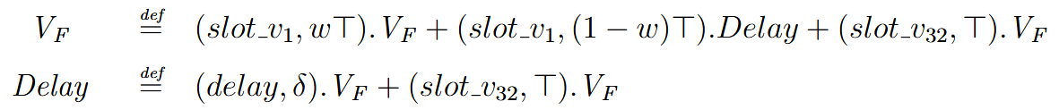
Fair Validator (VF)
The Fair Validator tries to always check if a block is valid, which might make him go into a Delay state, i.e., he hasn’t yet submitted its vote, which means that he is “late” and will incur in penalties.
We can see that with probability ⍵ he will not go into the Delay state. If he’s in the delay state he’ll exit with rate ẟ.
Notes:
Similmente alla slide precedente, fare notare che la parte finale con slot_vn serve per effettuare la sincronizzazione sulla fine dell’epoca, visto che è anche presente in entrambi i componenti VF e Delay
δ -> delta
⍵ -> omega

Slide 11
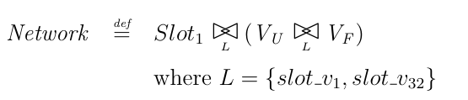
Network Component
This is the composition of the slot mechanism, the fair validator, and the unfair validator.
It represents the full model of consensus behaviour within an epoch.

Slide 12
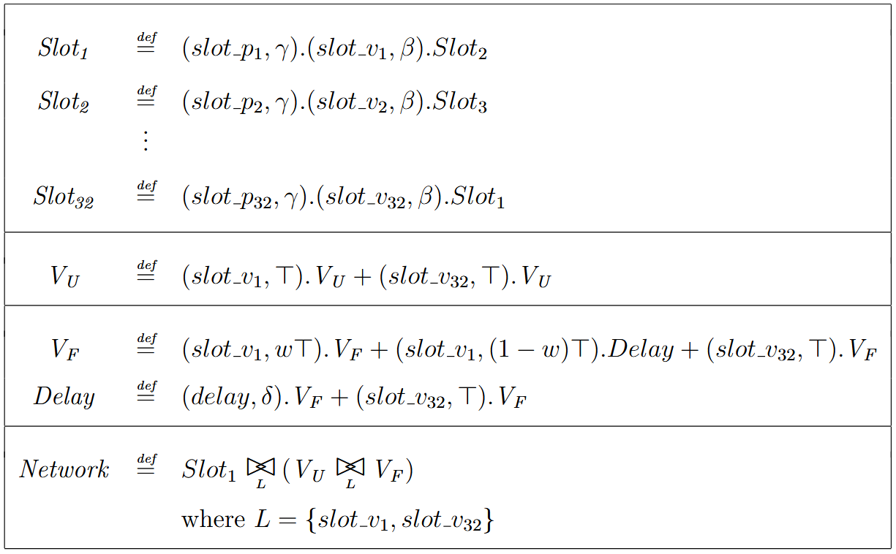
All Together
By putting all together, we get the complete PEPA model.
Notes:
Fare notare che c’è anche la cooperazione con network per far girare il tutto correttamente.
Notare che gli slot non sono solo 2, ma N in totale (specifichiamo dopo quando mettiamo in chiaro i parametri)
Altra nota: slot_i verrà “separato” a metà in automatico da PEPA negli stati per fare analisi sullo “stato” intermedio in cui un vérifier va in delay ma riesce ad uscire da questo stato nello stesso slot
-> non abbiamo un mapping perfetto 1 ad 1 fra componenti e stati, obw

Slide 13

Derivation Graph
It’s a labelled transition system, which is called derivation graph, such that :
S is the set of states
T is a set of labels for the transitions
is a transition related to every

Slide 14
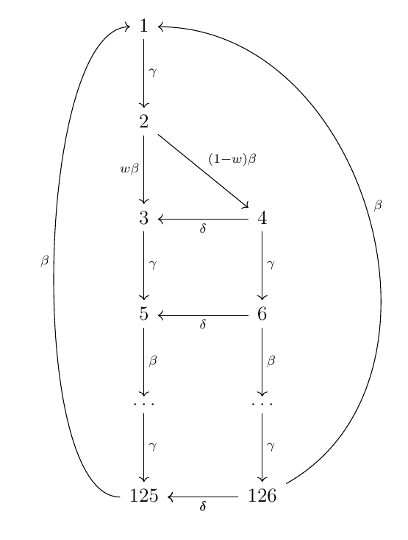
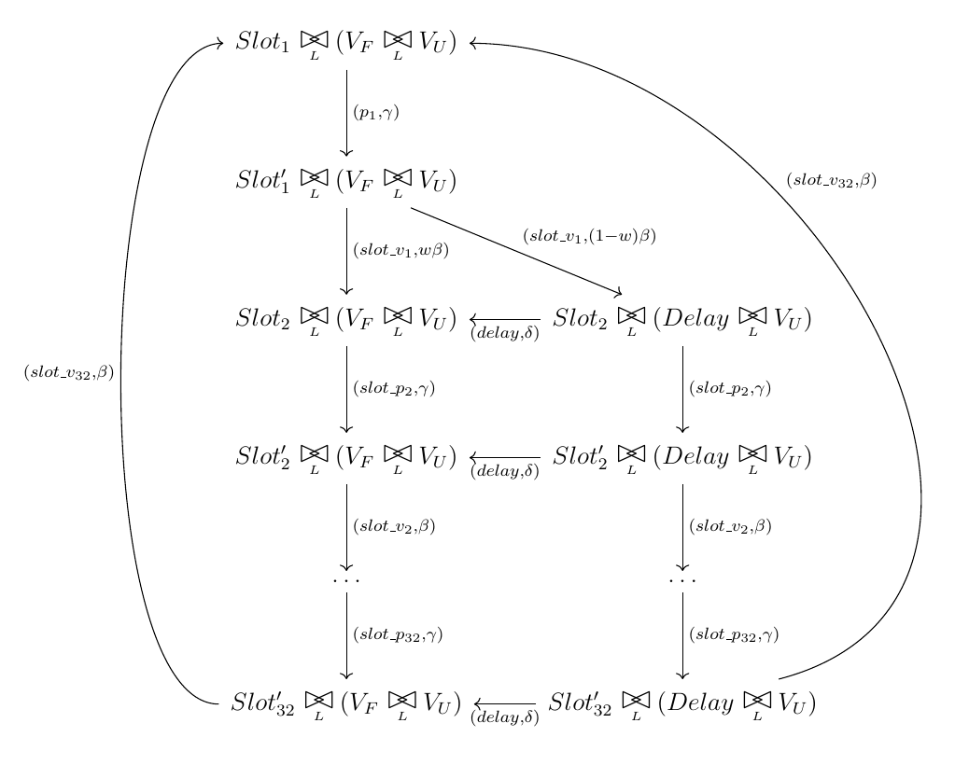
Derivation Graph
This is our derivation graph and the related CTMC
Notes:
Fare notare la divisione in due colonne, una per gli stati in delay e l’altra per quando non si è in delay.
Fare notare lo “stato” intermedio che permette ad un VF di andare in delay ed uscirne nello stesso slot

Slide 15
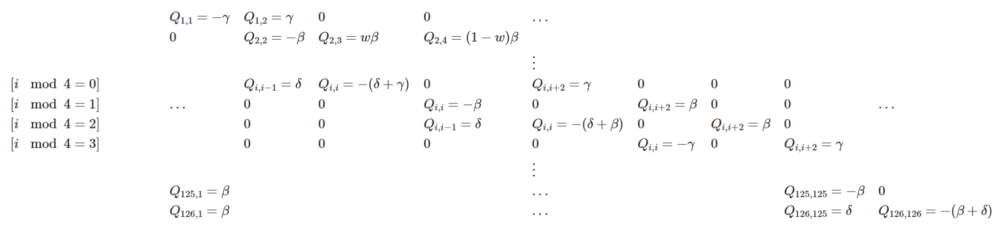
Infinitesimal Generator Matrix
It’s similar to the Derivation Graph, even if it doesn’t allow self-loops, doesn’t have labels on the transitions, and the transitions from a state to another get “merged” and their rates are summed up.
Notes:
Fare notare l’exit rate negato sulla diagonale, cosa che implica che i self loop non servano visto che il tempo di permanenza nello stesso stato è già incluso li
Reminder che l’exit rate è la somma di tutti i transition rate in uscita da un certo stato
Questa è la soluzione simbolica, dobbiamo fissare i parametri per fare le analisi

Slide 16
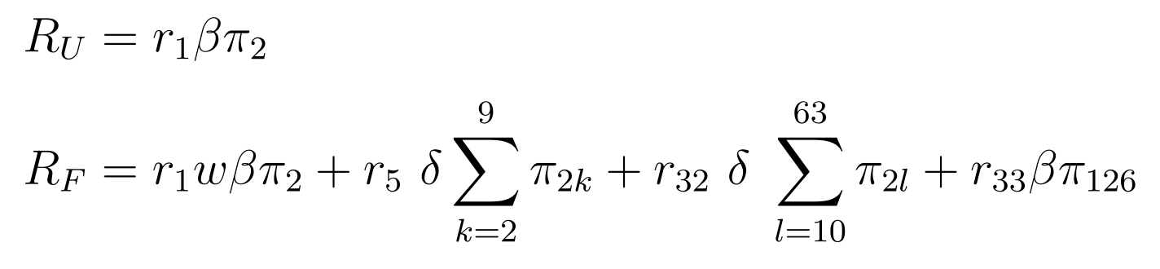
Parameterization
To actually conduct some analysis, it’s easier to set our parameters:
n = 32 number of slots
γ = ¼ block proposal rate
β = ⅛ voting rate
δ = ¼ “delay end” rate
⍵ = 0.99 proportion of delay events
These are the “parameters” that are currently being used by the Ethereum blockchain
Notes:
L’1% di delay è un’assunzione un po’ pessimistica ma reale dovuta a problemi con la rete o validatori che passano più tempo a “pensare”
Vediamo anche la formula per il calcolo delle reward, nel caso di RF abbiamo reward in orario, somma reward uscita delay prima fascia, somma reward uscita delay terza fascia e reward (negativa) su quarta fascia causa fine epoch
-> r_n sarebbe reward con delay fino allo slot n
γ gamma
ꞵ beta
δ delta
⍵ omega

Slide 17
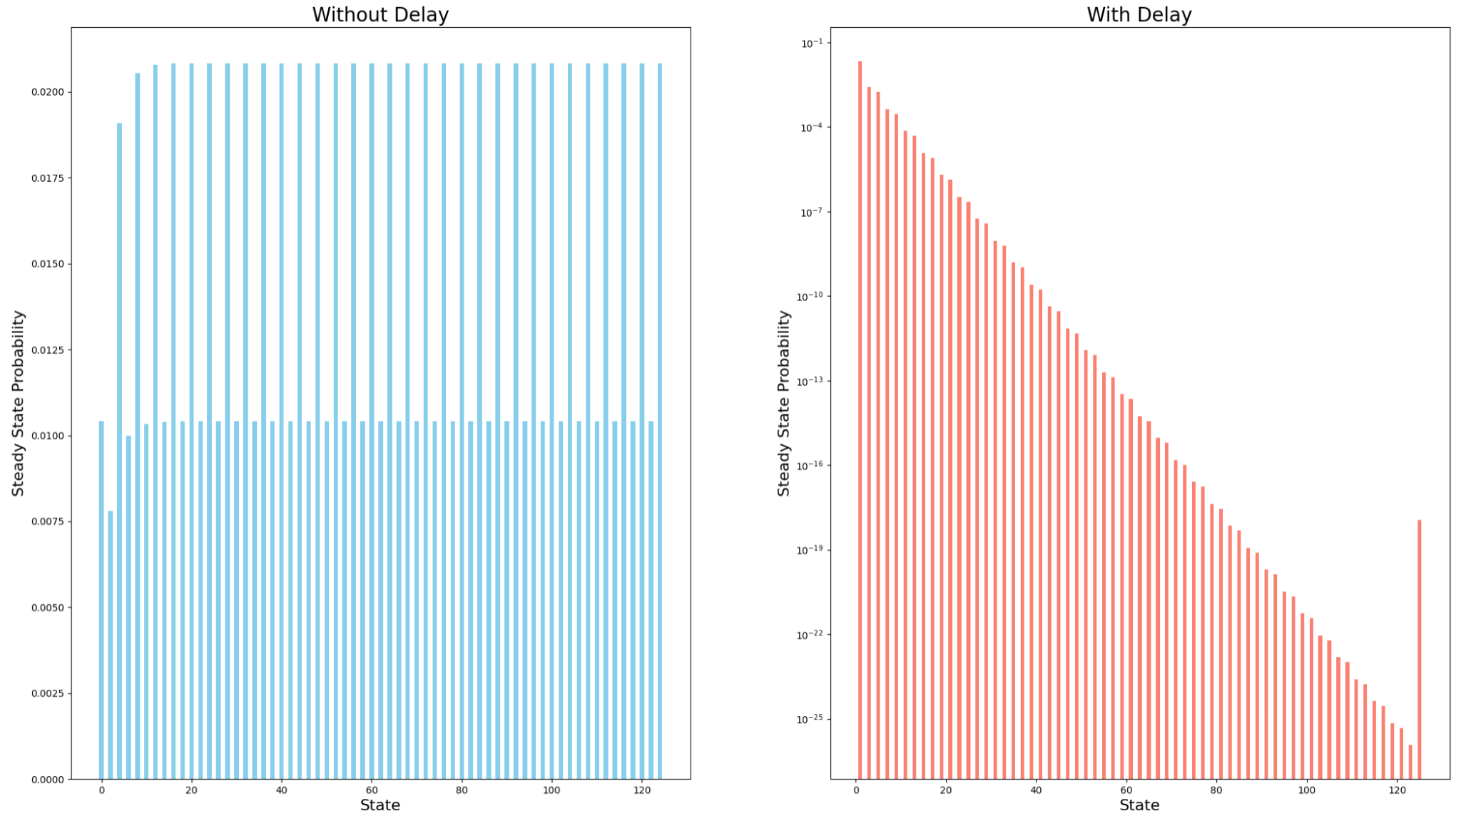
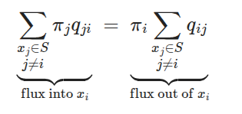

Steady State Probability
It’s a collection of π_i that represent the portion of time the system stays in each corresponding state. Given the previous parameters, we obtain the following:
Notes:
I singoli valori delle steady state probability gli otteniamo settando la probability flux in entrata dello stato è uguale a quella in uscita, ovvero $$\sum (\pi_j q_ji) = \pi_i (\sum q_ij) $$
Le global balance equation le otteniamo riarrangiando la formula precedente in $$\pi \times Q = 0$$, con Q l’infinitesimal generator matrix, a cui aggiungiamo (sostituzione riga) la normalization condition $$\sum \pi_i = 1$$

Slide 18

Performance Measures
The Utilization is a measure that tells us the portion of time the system has spent in a subset of states. We can use it to measure the mean rate at which the Fair Verifiers spends checking for the validity of blocks.
Rules | Utilization
Delay | 0.01099
VF | 0.98900
VU | 1
Notes:
Calcoliamo questa misura come la somma delle steady state probabilities degli stati che ci interessano, oppure la sommatoria delle stesse con pesi 0 o 1

Slide 19
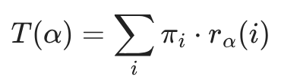

Performance Measures
The Throughput measures the rate at which certain events happen. In our case, we’ll use it to verify how much time it takes to go through every slot.
Action | Throughput
slot_p1 | 0.002604
slot_v1 | 0.002604
slot_p2 | 0.002604
... | ...
Notes:
Il throughput è la sommatoria delle steady state per il rate apparente di ogni stato interessato, ovvero z
rho e’ la reward function, per il throughput e’ settata al rate apparente
dire che gli slots sono approssimabili a una catena, quindi il throughput e’ sempre uguale.

Slide 20
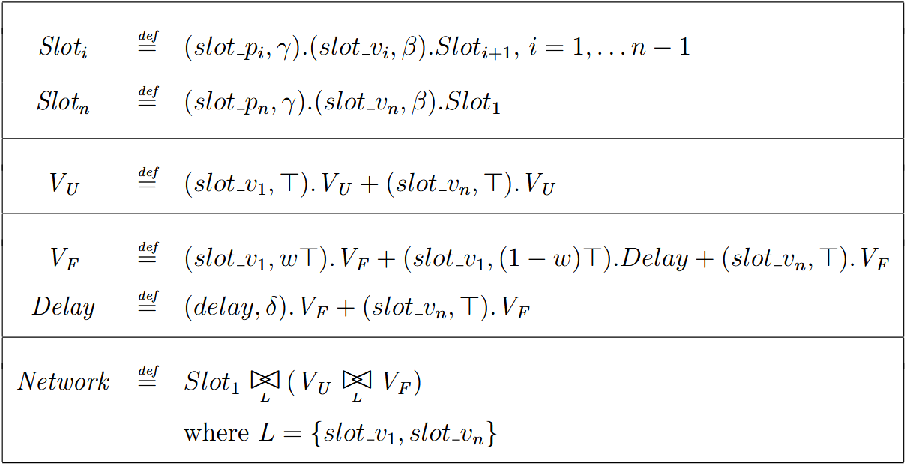
Parametrizing the Model
Notes:
Esattamente come il modello precedente, solo che abbiamo i parametri come variabili

Slide 21
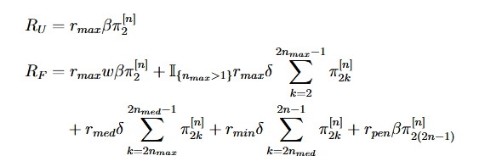
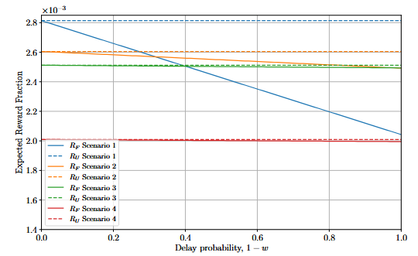



Vote delay impact
Scenario
1 | 1 | 3 | 25
2 | 2 | 6 | 27
3 | 3 | 8 | 28
4 | 3 | 10 | 35
Notes:
Dire che l’unfair ha sempre il massimo (non si basa su w)
scenario 3 e 4 il delay ha meno impatto -> la reward massima è data non solo al primo slot, ma anche al secondo e terzo

Slide 22
Vote delay impact
Scenario
1 | 1 | 3 | 25
2 | 2 | 6 | 27
3 | 3 | 8 | 28
4 | 3 | 10 | 35
5 | 2 | 9 | 30

Slide 23
Mitigation Strategy
To discourage opportunistic validator behavior, the following mitigation strategies should be implemented:
Blind Voting: validators cannot observe others votes before submitting their own, preventing strategic free-riding
Invalid Block Injection: the system deliberately introduces invalid blocks at a controlled rate and, given that only validators who verify blocks can detect invalidity, those that vote blindly will be exposed
Punishment Mechanism: validators who vote against the consensus receive a penalty, which disincentives dishonest behavior
Only the combination of these mechanisms provides effective mitigation of the Verifier’s Dilemma.

Slide 24
Unfair Validator with Punish
With the punishment component we have that with a certain probability ε the Unfair Validator will incorrectly vote for the validity of a block, i.e., the casted vote is against the consensus.
Notes:
Dire che Punish non viene applicato ai fair validator, perché verificano effettivamente i blocchi prima di castare il voto
η eta -> rate di punishment dell’unfair validator

Slide 25
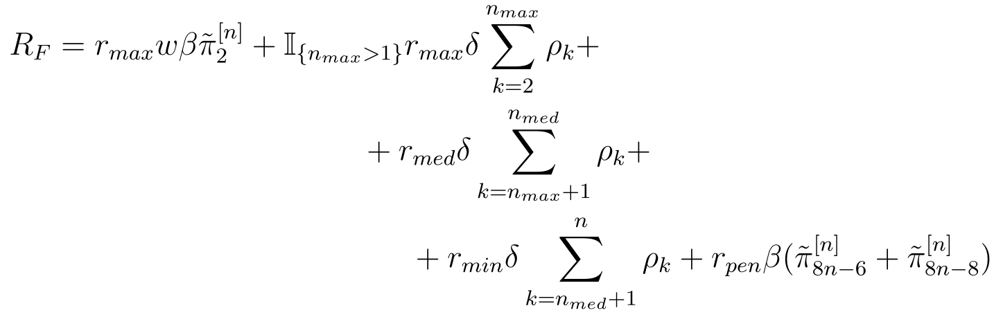
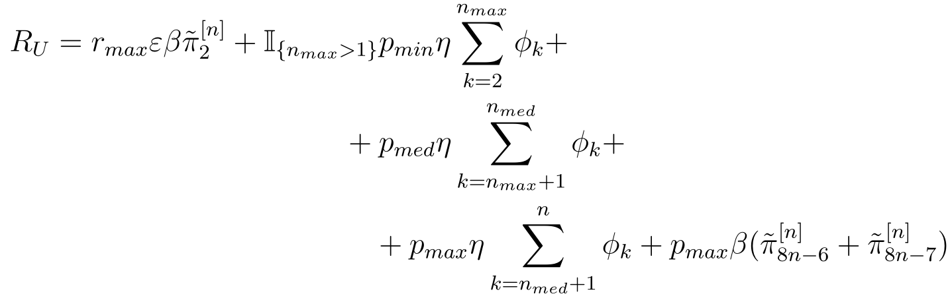
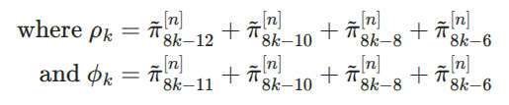
Unfair Validator with Punish
Here is a comparison of the reward functions
Notes:
Possiamo vedere come siano pressoché identiche, solo che nella seconda per il punish abbiamo dei valori di punish basati sul numero di slot rimanenti

Slide 26
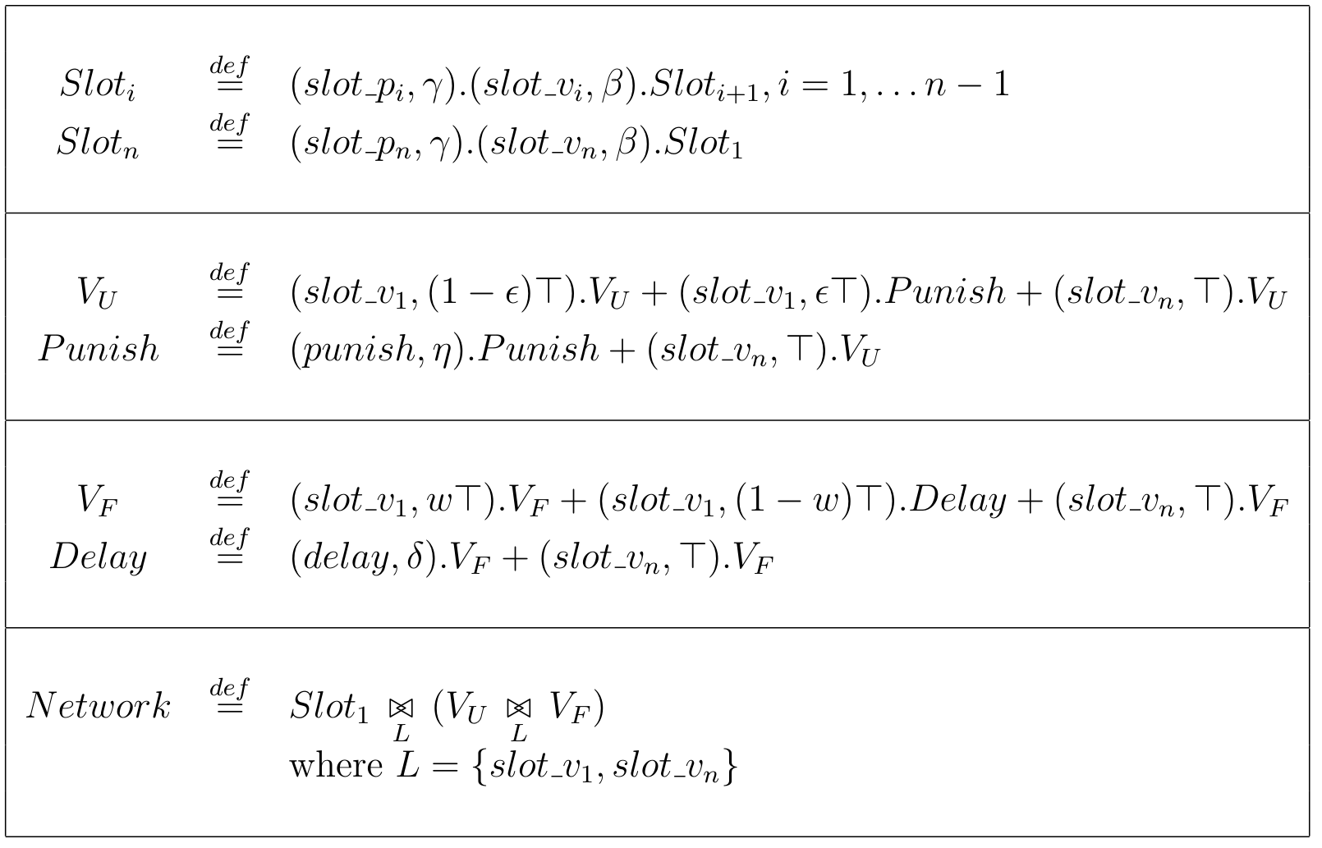
Complete Model with Punish
IL PAPER NON HA IL PEPA COMPLETO DECENTE

Slide 27
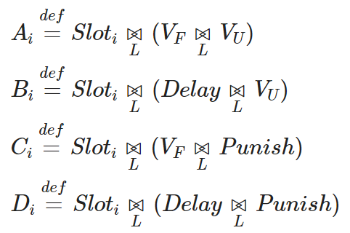
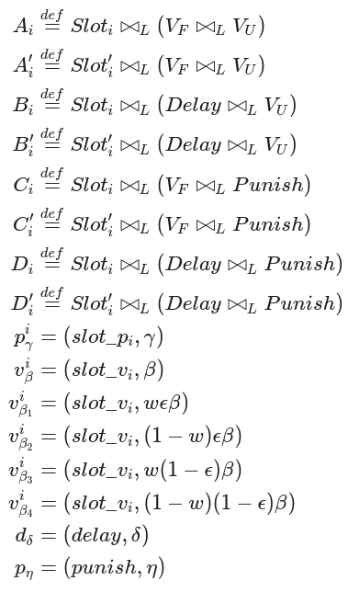
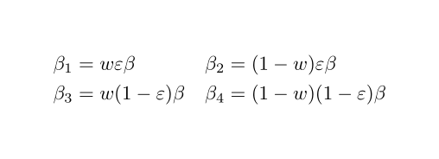
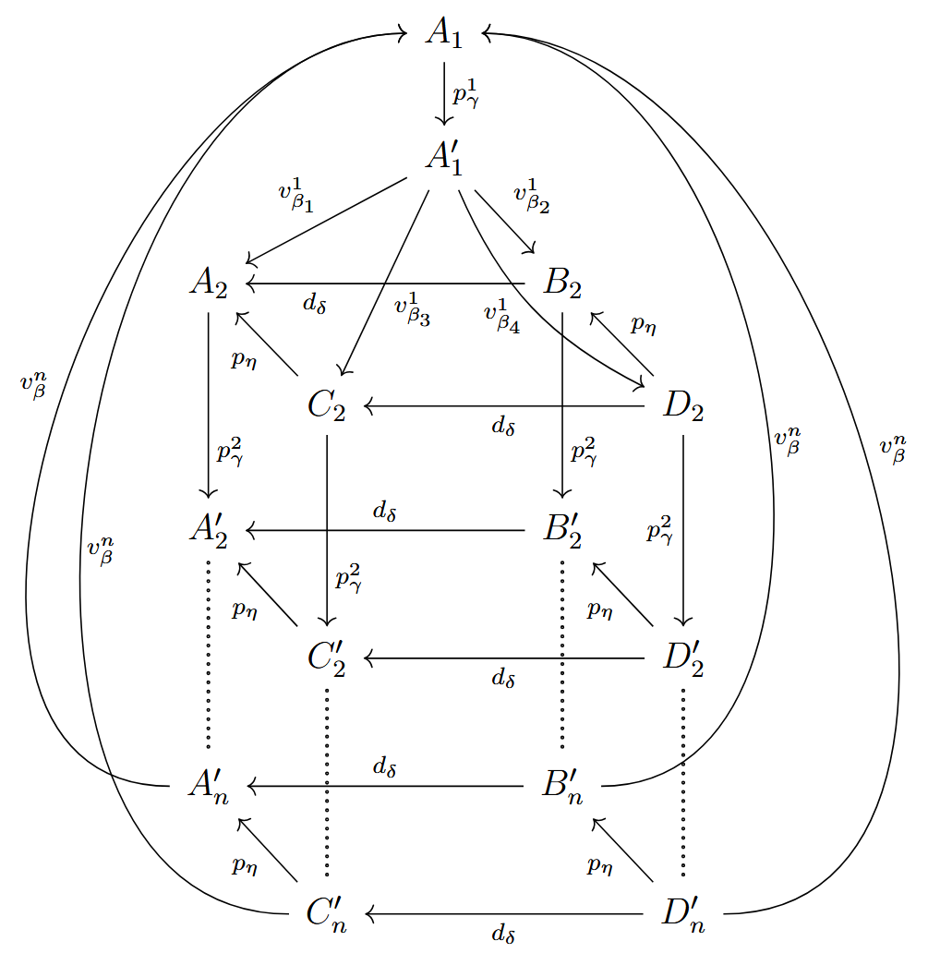
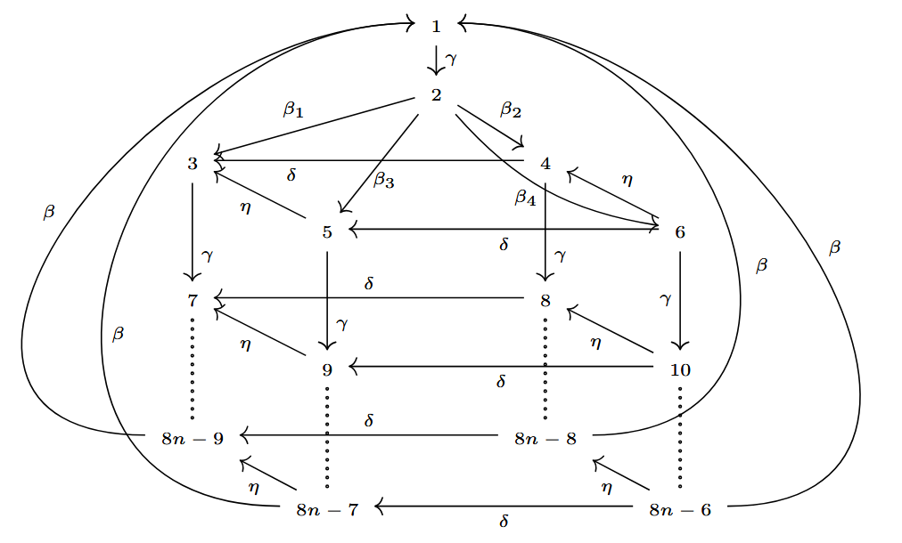
Derivation Graph

Slide 28
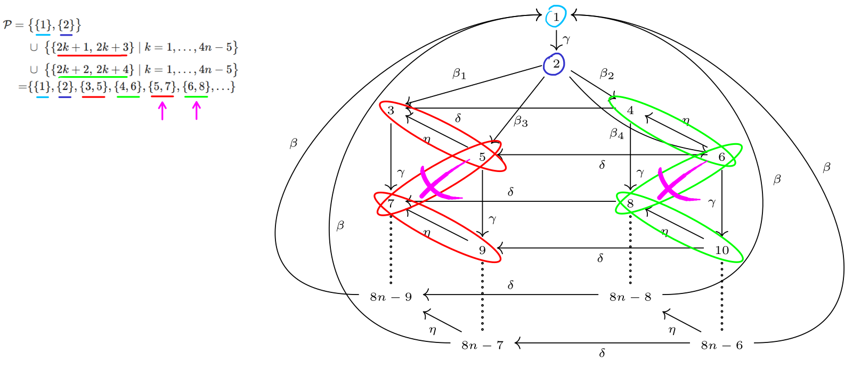
Lumpability
We firstly need to define a partition of the previously found states that can be considered equivalent. In this case, we can aggregate the states such that we reconduct the latest derivation graph to the starting one.
Notes:
Dire che dal paper la partizione proposta ha stati che si sovrappongono, quindi è sbagliata

Slide 29
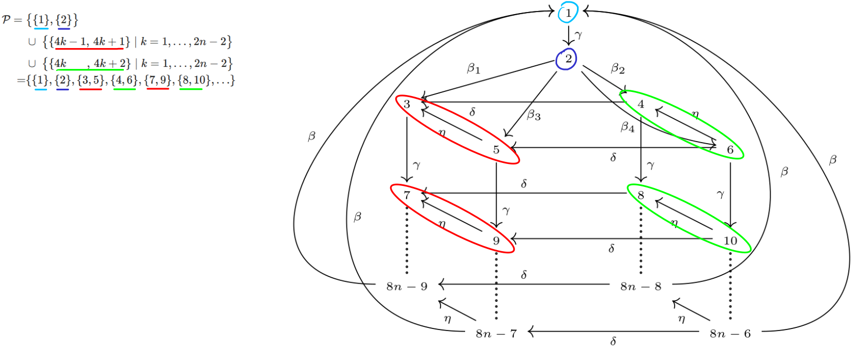
Lumpability
We firstly need to define a partition of the previously found states that can be considered equivalent. In this case, we can aggregate the states such that we reconduct the latest derivation graph to the starting one.

Slide 30
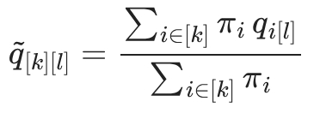
Lumpability
The equivalent states are such thanks to an equivalence relation that is reflexive, symmetric and transitive.
The macro-states will have a transition rate calculated with the following formula, which will be used to populate the new CTMC:
Based on the used equivalence relation to create the partitions, we can also have other “kinds” of lumpabilities.

Slide 31


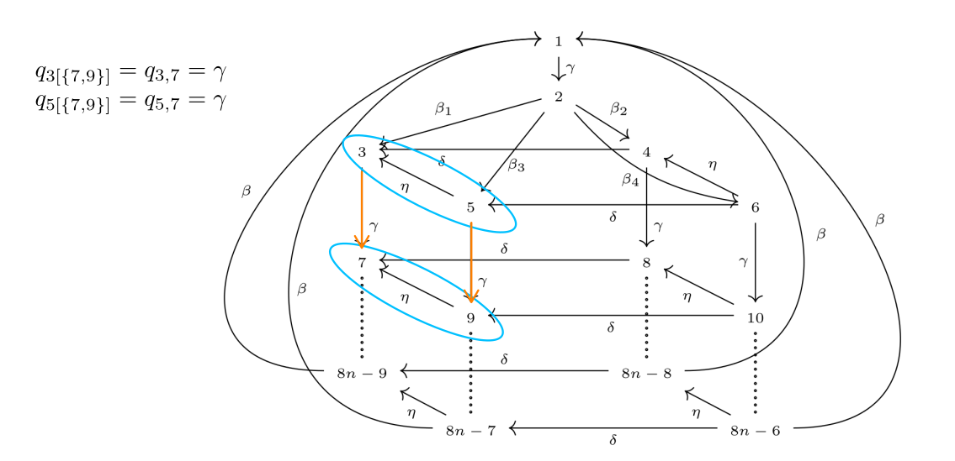
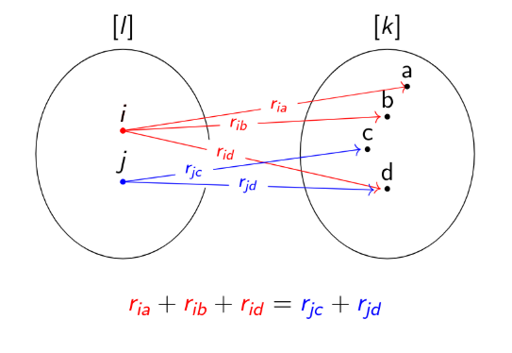

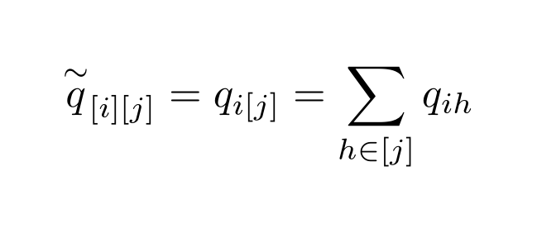
Strong Lumpability
We can show that the strong lumpability, given that for the previously defined equivalence relation and for each different class we have:
Notes:
Fare notare la proprietà principale ovvero che la steady state del macro-state è pari alla somma delle singole steady state probability degli stati che la compongono.
Notare come i rate da mettere nella CTMC aggregata siano la somma dei rate della CTMC precedente
Abbiamo anche che i transition rate che mettiamo nella CTMC “aggregata” saranno la somma dei rate in uscita (e.g. quelli in rosso o quelli blu visto che sono uguali)
γ gamma
ꞵ beta
δ delta
⍵ omega

Slide 32


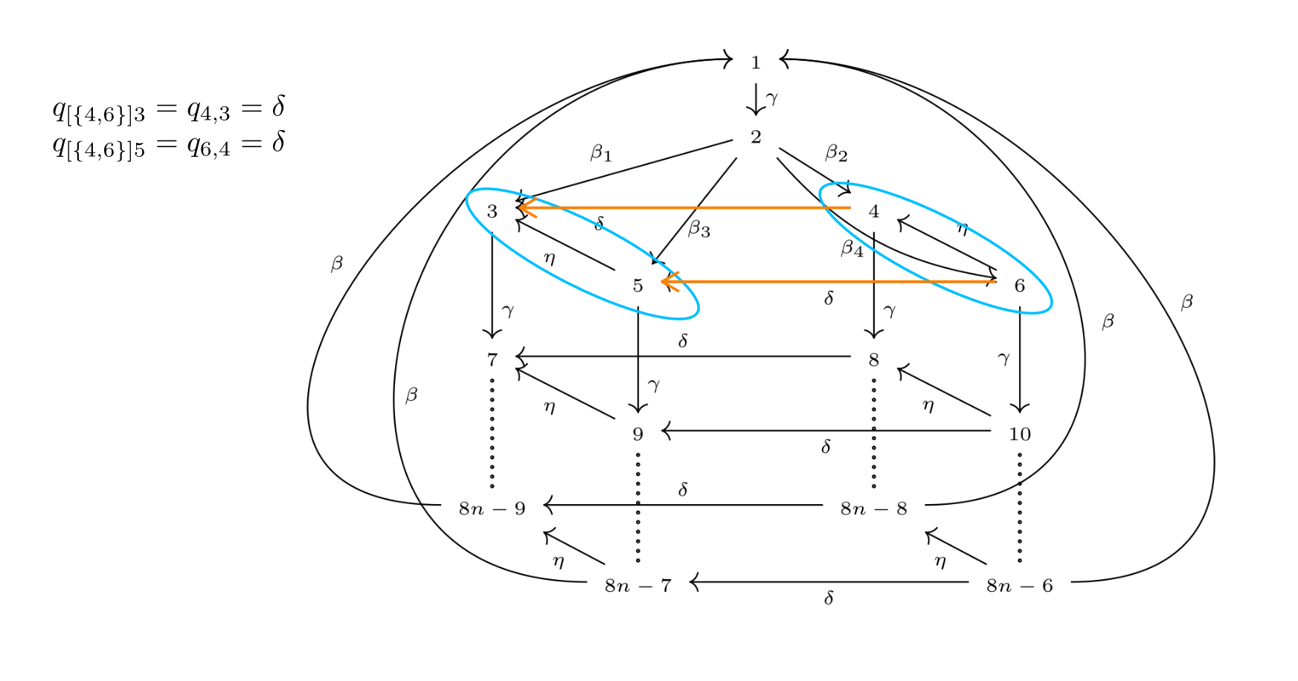
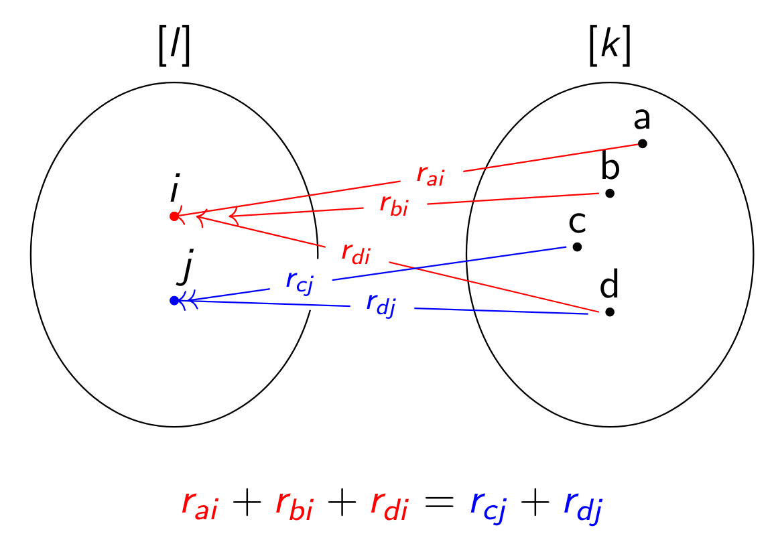

Exact Lumpability
We can show we have exact lumpability in a “similar way” to the strong lumpability:
Notes:
L’exact lumpability ci dice che la steady state degli stati di una singola classe è tutta uguale
γ gamma
ꞵ beta
δ delta
⍵ omega

Slide 33
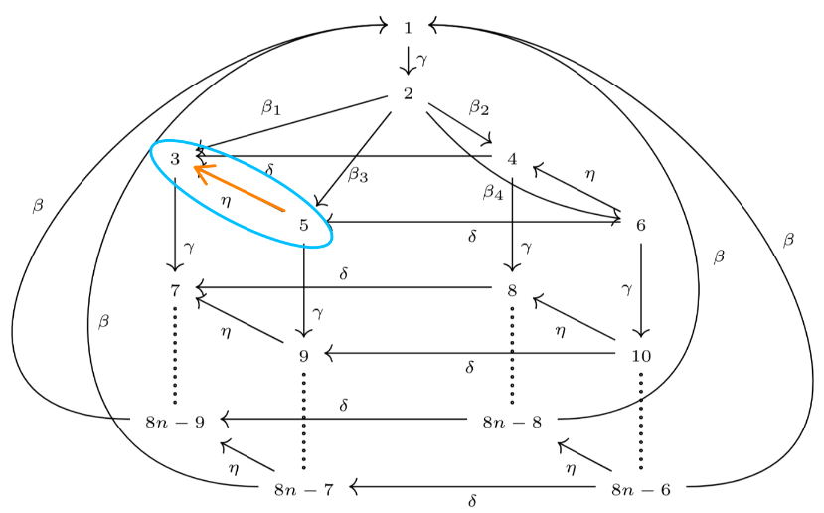

Exact Lumpability
But exact lumpability does not need the two classes to be different
Notes:
γ gamma
ꞵ beta
δ delta
⍵ omega

Slide 34






Strict Lumpability
Strict lumpability happens only when strong and exact lumpability are valid.
If strict lumpability were valid, we would have the following properties:
is a Markov process
forall states such that
forall

Slide 35
Exact Lumpability
We can show we have exact lumpability in a “similar way” to the strong lumpability:
Notes:
L’exact lumpability ci dice che la steady state degli stati di una singola classe è tutta uguale
γ gamma
ꞵ beta
δ delta
⍵ omega

Slide 36
Strict Lumpability
Given that we have strong and exact lumpability, we also have strict lumpability. This means that we have the following properties:
is a Markov process
forall states such that
forall

Slide 37
Lumped Models
Here we can see what is the result of the lumped model The CTMCs are shown for a cleaner look and, for this specific case, the transitions remains untouched.
Notes:
Dire che con “untouched” vogliamo intendere che non ne vengono rimosse/aggregate alcune, semplicemente non sono mostrate le label
⍵ omega
ꞵ beta
γ gamma
δ delta

Slide 38
FINE!!

Slide 39


Strong Equivalence
Finally we could also prove that the 2 previously shown models are strong equivalent to each other. This could be done by using the definition, i.e., whenever
, and we must have that .
This property is essential to simplify models and analyze them if, for example, they have too many states.
Notes:
Bisimilar/strong equivalence: osservando dall’esterno due sistemi essi sembrano avere un comportamento equivalente (bissimilar guarderebbe le label delle transizioni che fa il sistema / guarda le trace, strong equivalence più i rate)
Sono uguali se facessimo finta di non sapere dell’esistenza del punish e “proiettassimo graficamente” in modo da sovrapporre i due stati di punish
Data un’equivalence relation R = C x C, dove C è il set di tutti gli stati possibili e R un “modo” di raggrupparli, se due stati (P,Q)\in R sono equivalenti per ogni action type “a” e per una certa classe S abbiamo che il transition rate con label a dallo stato P alla classe S con action alpha è uguale al transition rate dallo stato Q alla classe S con action type alpha.
Trace equivalence: compara solo le realizzazioni, non distingue fra deadlock

Slide 40




PEPA - Prefix
Component
Apparent Rate
Immediate Activity
SOS Semantic Rule

Slide 41



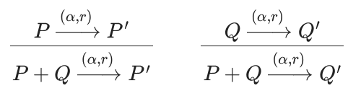
PEPA - Choice
Component
Apparent Rate
Immediate Activity
SOS Semantic Rule

Slide 42

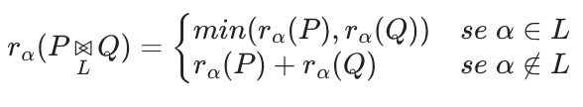
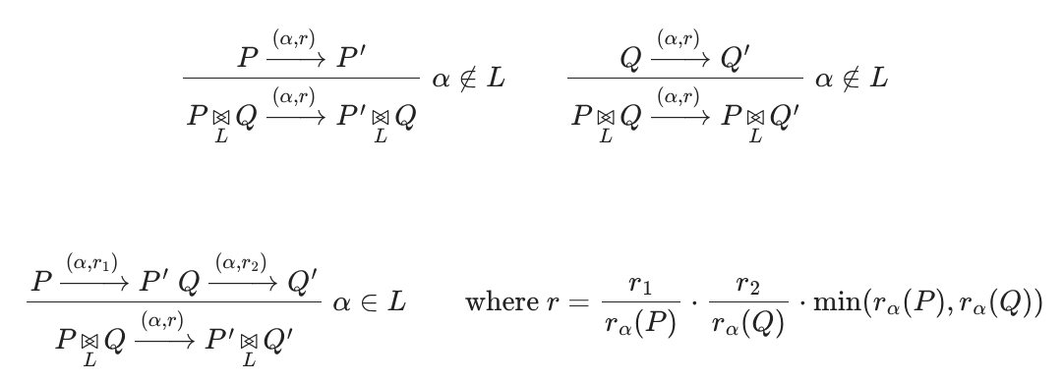
PEPA - Cooperation
Component
Apparent Rate
Immediate Activity
SOS Semantic Rule

Slide 43


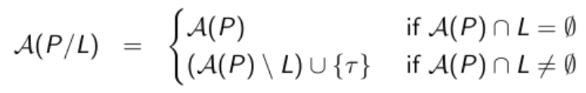
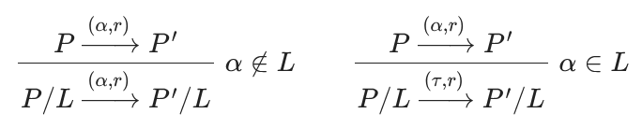
PEPA - Hiding
Component
Apparent Rate
Immediate Activity
SOS Semantic Rule

Slide 44

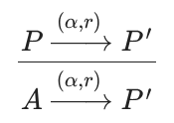
PEPA - Constant
Component
Apparent Rate ??????
Immediate Activity ??????
SOS Semantic Rule

Slide 45
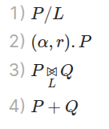
PEPA - Operator Precedence

